Slide 1

NDMA CUAS Specialist Course
Deployment Setup of system

Slide 2

Deployment – Siting the system
Locate suitable ground, as level as possible, for the deployment of the container. The adjustment legs can be used to accommodate a 5-degree incline.
If shore supplies are to be utilised, ensure that the container is placed in a location that has access to 3 x 16A shore power supplies at a maximum distance of 20m using cables 2169-W44. The cables have standard commando plugs.
If the diesel generator is to be utilised, allow for 20-30L diesel consumption per 10h of system operation.
Ensure container is not located within ~50M of building and tall metallic structures (Radio masts).
Ensure adequate line of site for the area to be protected.

Slide 3
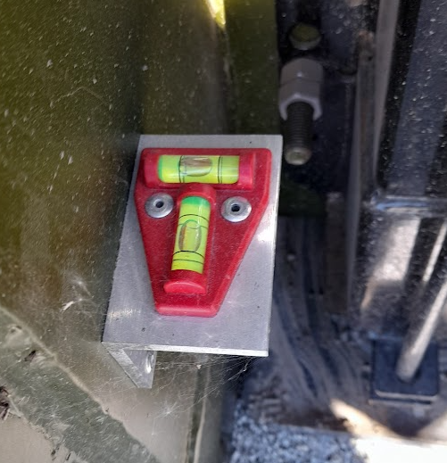
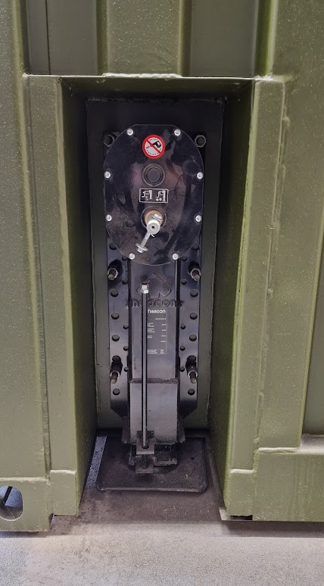
Deployment – Levelling the system
Handles are located on the equipment bay doors
Levels are fitted to the container at each leg.
Wind legs up/down until container is as level as possible.
If the system is too far out of level, this could severely impact performance of the system

Slide 4
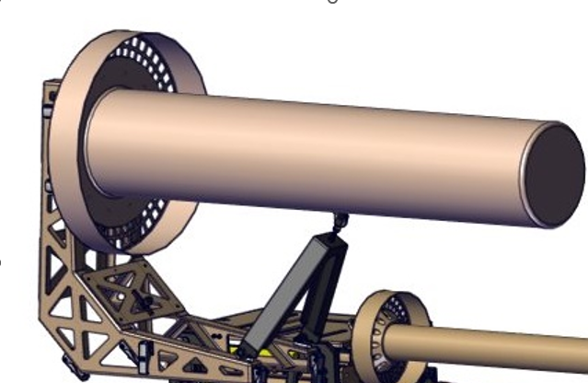
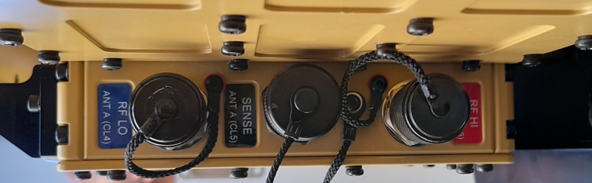
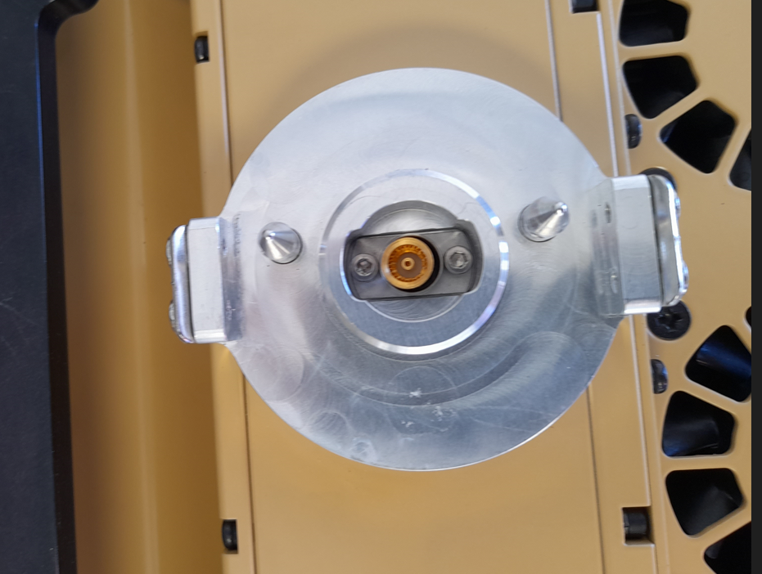
Deployment – RF Defeat Antennas
During Transport, Antennas are removed as this are delicate parts of the system.
These are stored in transport cases in the operator bay.
Smaller antennas can be fitted before the mast is raised.
Check antenna connector are clean and dry.
Fit A Antenna to it’s mounting frame and mount from the roof for ease of access.
There are 3 cables to connect which are colour coded to the CLAW unit. (As shown)

Slide 5
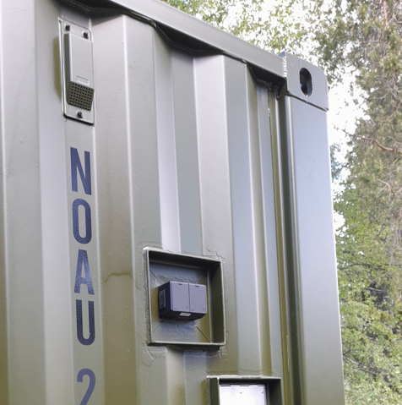
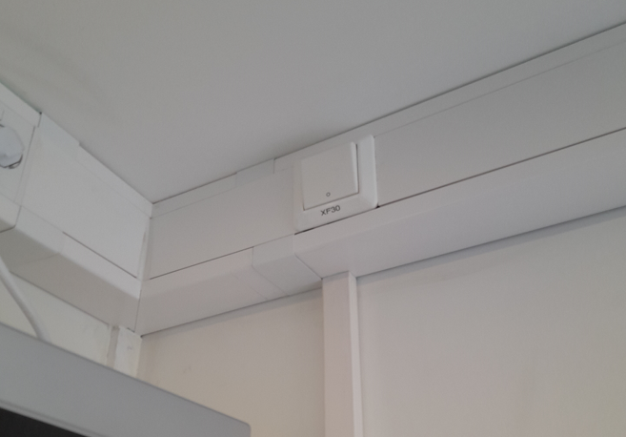
Deployment – Aircraft Warning Light
To be deployed on the container under following conditions:
When requested to do so
When the container is located in an area low flying aircraft activity
When located at an elevated location
An external power feed is supplied
The Warning Light and attachment can be fitted to the corner of the container
The power swich is located in side the container.

Slide 6
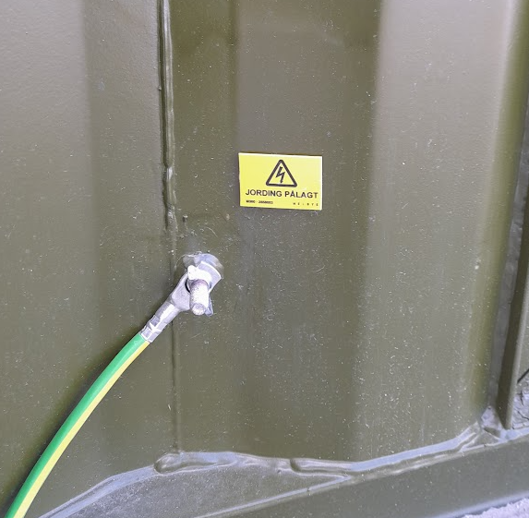
Deployment – Earthing the system
Connect the supplied Earthing rod to one of two Earth points found on either side of the container.
Using a hammer, knock the earth rod in the ground where suitable.

Slide 7
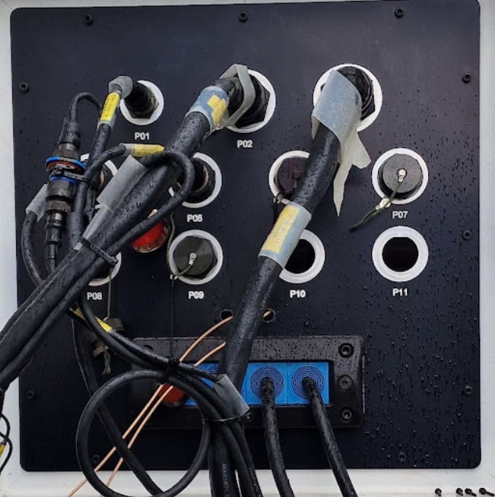
Deployment - Connection of Metis and Squarehead
Metis and Square head can be powered from 2 x 16a sockets available in the equipment bay.
Ethernet connections can be made to any spare port on the Interface panel in the equipment bay.
P06, P07, P08 or P09

Slide 8
Deployment – Mechanical System Checks
Mechanical Checks
Once system has been delivered to location, a number or mechanical checks should be performed.
Visual check of the equipment, especially camera lenses.
Clean as necessary.
Check colour of desiccator windows.
Check the condition of all of the external cables and their back shells.
Check connections are secure and correctly seated
Repair or replace damaged cable sheathes as appropriate.
Check the security of all fastenings and tighten as required.
Check mast and associated air hoses for signs of wear or damage.
Check Fire extinguishers are in service date
Notes:
EO camera, Thermal camera, LRF
Add threadlock if repeatedly getting loose screws/bolts
Desiccator – indicates moisture getting into the system. Blue = good, pink = bad.

Slide 9
Deployment – Operational System Checks
Operational Checks
Prior to the system being utilised, several operational checks should be performed:
The mast raises once pressurised and pump cuts out at the expected pressure.
The system powers on and boots as expected.
Check no breakers have tripped on the Rack Junction Box (RJB).
Images visible from both cameras (Daylight TV and Thermal).
The GPS has picked up current location information.
Radars power up and start scanning.
Jamming equipment powers up, interlocks working as expected.
All system components show a “Green” healthy status in the VMS.
All system components show a “Green” healthy status in the CMS.
System moves when commanded via the control pad.
Check Digital Cross Hair Alignment (to be covered in another chapter)
Check Image Fusion alignment (to be covered in another chapter)
Radar tracks are aligned with expected positions on the map.
When slewing from CMS, radar tracks can be seen as expected on the DLTV and TI.
Notes:
EO camera, Thermal camera, LRF
Add threadlock if repeatedly getting loose screws/bolts
Desiccator – indicates moisture getting into the system. Blue = good, pink = bad.

Slide 10
Deployment – Radar Optimization – Tracking Performance
Considerations:
  Changes in surrounding terrain elevation.
  Nearby objects causing blind spots and radar reflections.
  Tracks created by objects moving in the wind.
  Nearby radar transmission sources creating interference.
Actions:
  Ensure the location and orientation of the container is optimised.
  Adjust CMS configuration, as necessary.
  Adjust CMS filters, as necessary.
  Verify configuration changes by performing test flights with a drone.

Slide 11
Routine Maintenance – Radar Optimization – Elevation Changes
Surrounding terrain elevation changes when siting the system.
Radar transmission elevation angle change diagram
Changes are performed in the CMS Configurator > Echodyne Echoshield Radar tab.

Slide 12
System Overview – Questions
Questions?

